Slide 1
Chapter 13
The Rise of a Mass Democracy

Slide 2
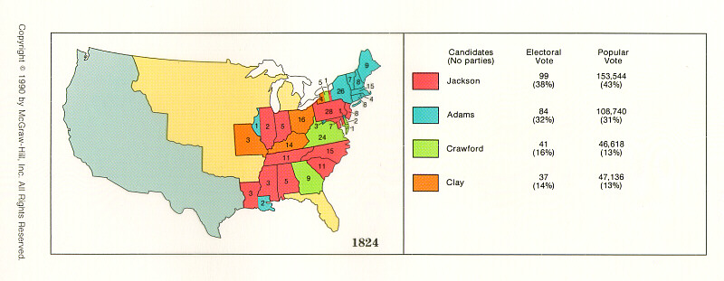
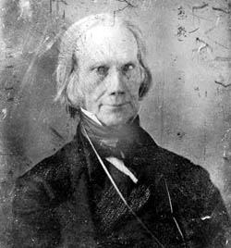
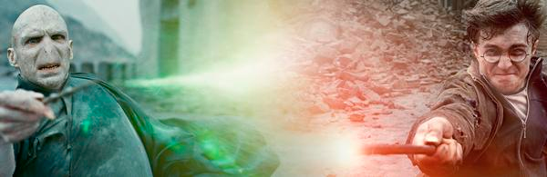
The “Corrupt Bargain” of 1824
4 candidates for president, none win majority of electoral votes; goes to House
Vote on top 3; as per 12th amendment; Clay out
Clay (Speaker of House) throws support to Adams
Adams wins, Clay becomes Secretary of State
Jackson, who won majority of popular vote is furious
Death, AKA “Henry Clay”

Slide 3
John Quincy Adams
Former Secretary of State (under Monroe)
Negotiated Anglo-American Convention, Adams-Onís Treaty (Florida), & Monroe Doctrine.
DID NOT use patronage, or spoils system
Party members began to question - why support him if there is no reward?
America began to turn towards sectionalism during this time; long removed from nationalism from War of 1812
****Review p. 250-251 on JQA background and policies!!!!

Slide 4
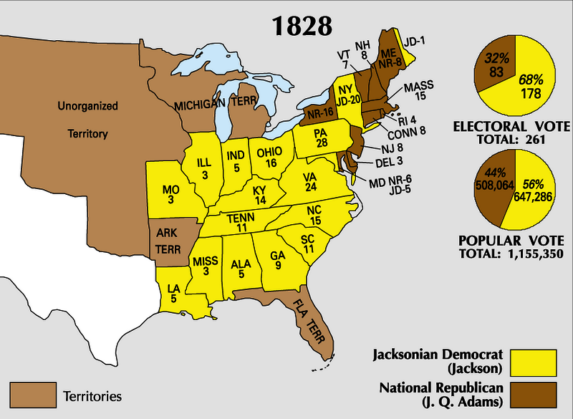
“Old Hickory” as President
Was seen as a “common man” since he was born in a log cabin
At the time (1828) he was a wealthy planter living in a luxurious manner off slave labor.
Democracy increases during his presidency:
Elimination of property requirements to vote
Universal white male suffrage
Strong unionist & nationalist (to dismay of South); federal supremacy over states.
Spoils System:
Rewarding political supporters with public office
Believed in a “rotation in office”
***Review p. 251-253 on A. Jackson!!!

Slide 5
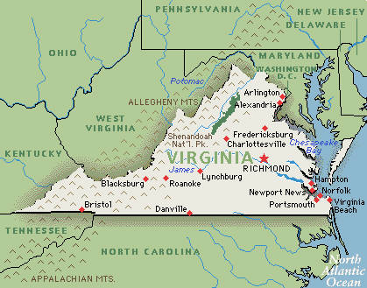
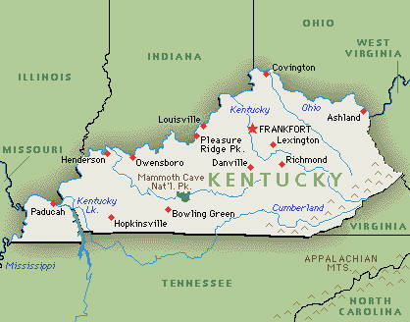
Tariff of 1828
Jackson supporters in Congress pushed for high tariffs, hoping to make Adams look bad
Tariffs surprisingly passes!
Jackson inherits a mess
What region would most be opposed to high tariffs? Why? (Hint: which section of U.S. does not own manufacturing?)
Tariffs, especially this one, promote sectional differences
South Carolina proposed that the states nullify the tariff
What two states tried to nullify the Alien and Sedition Acts?

Slide 6
“Nullies” in South Carolina
Tariff of 1832
Reduced the tariff amount, but still high enough to anger the South
South Carolina legislature nullifies tariff
Threatened to secede from union if federal government tries to collect duties
Jackson threatens to hang “nullies,” including his former VP Calhoun!
Calhoun was JQA’s VP
Now AJ’s VP (say what?)
Wrote South Carolina Exposition arguing against tariffs artificially boosting business in one area.

Slide 7
Continued
I’m Back Baby!!!!! My 2nd Major Compromise in 13 years.
Henry Clay helps resolve the issue!
Compromise Tariff of 1833:
Tariff would be reduced by 10% per year for 8 years
Civil war is averted
Force Bill passed by Congress as face-saving device
President in the future could use military to collect
federal tariffs if necessary.
Dubbed "Bloody Bill" by South Carolinians.
Impact: Stepping stone to Civil War; SC eventually moves from nullification to secession

Slide 8
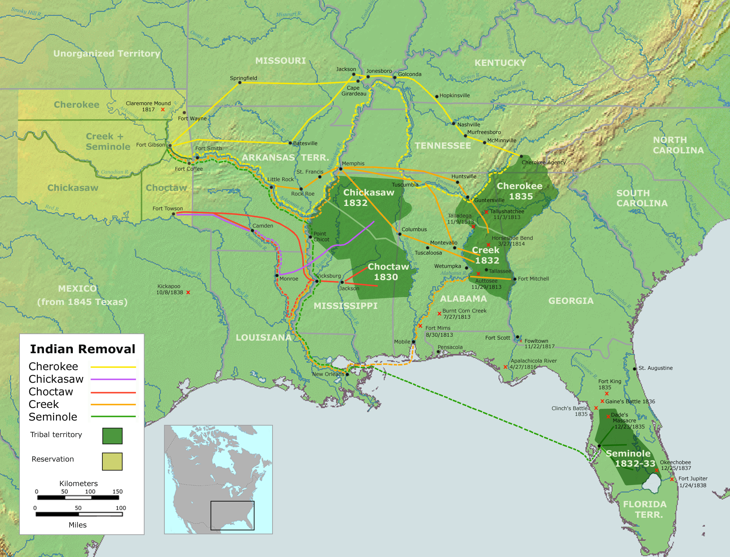
The Trail of Tears
1790s, US government recognizes tribes as separate nations; agrees to acquire land through formal treaties (Treaty of Greenville and GW)
Indian Removal Act (1830)
Removal of Natives (inc. 5 “civilized” tribes) beyond the Mississippi River
“Trail of Tears”
18,000 Cherokees forcibly removed from their homes and marched 1,000 miles to Indian Territory (Oklahoma)
Would be “permanently” free of white encroachments
Black Hawk War
Led by Jefferson Davis and Abraham Lincoln (say what?)
‘bet you didn’t know about this part of their legacy, huh?

Slide 9
2 important Court Cases
Cherokee Nation v. Georgia (1831)
Court ruled that the Cherokee nation was not a foreign nation with the right to sue in Federal Court
Worcester v. Georgia (1832)
Ruled that the laws of Georgia had no force within the boundaries of the Cherokee land and the Cherokee could not be required to move West.
Jackson: "John Marshall has made his decision; let him enforce it if he can."

Slide 10
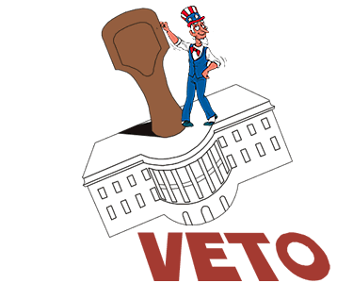
The Bank War
Jackson hated BUS, declaring it unconst.
Vetoed new charter of bank
McCullough v. Maryland
Used the veto 12 times in presidency, ALL presidents combined for 10 vetoes prior to Jackson
1833, Jackson decides to bury bank by removing federal funds
Nicholas Biddle, president of bank, calls in loans, creates a “panic”
1836, economy is spinning out of control, Jackson issues, Specie Circular:
All public lands be purchased with “hard” currency
Helps contribute to panic and crash in 1837

Slide 11
The Two-Party System
Democrats
Whigs
Favored local rule
Limited government in social and economic affairs
Glorified liberty of individual
Free trade, equal economic opportunity (for white males)
Made up of Southerners and westerners
Favored Clay’s American System (national harmony of society)
Opposed immorality and unlimited immigration
Made up of New Englanders, Protestants, Anti-Masonites, middle class urban professionals.
Favored a renewed national bank, protective tariffs, internal improvements, public schools, prohibition of alcohol, and abolition of slavery

Slide 12
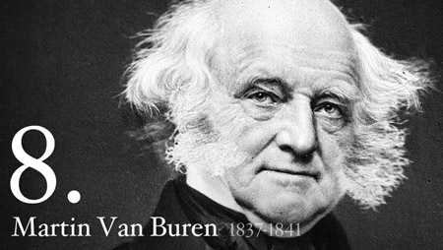
The Election of 1836
Martin Van Buren, VP during Jackson’s second term
Not able to decide on a candidate, Whigs hoped to throw election into House
Clay elbowed aside and William Henry Harrison (Battle of Tippecanoe)
MVB wins 170 – 124 (for all the Whigs combined)

Slide 13
Panic of 1837
What caused Panic of 1837?
Speculation of western land (AJ)
Bank War (AJ)
Specie Circular (AJ)
Failure of wheat crops (MVB)
Hessian fly (brought to the US by Hessian soldiers during Revolutionary War)
Pet Banks:
Banks which the government deposited funds after death of BUS (AJ)
“Divorce Bill”:
Separating the government from banking altogether (MVB)
GOVT funds would be locked in larger cities and thus safe but denied to states in reserve
Independent Treasury Bill (1840)
Later repealed, then reenacted, it separated government funds from private banks (MVB)

Slide 14
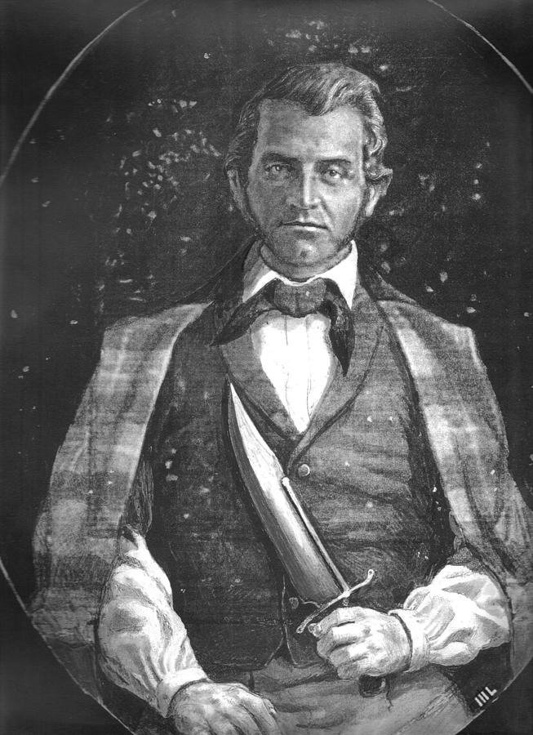
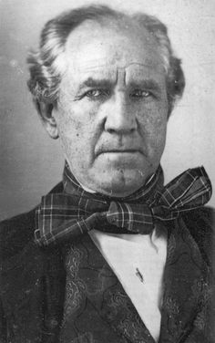
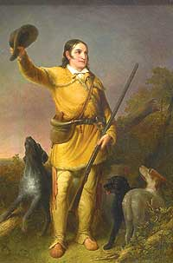
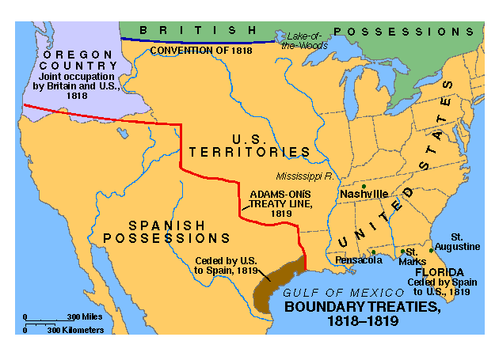
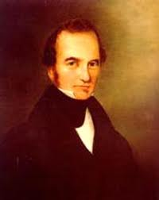
Gone to Texas
Mexico becomes independent in 1821
Florida & Texas, Missouri Compromise
1823, a newly independent Mexico granted Stephen Austin what is today Texas:
Immigrants were to be Catholic
Properly Mexicanized
Davy Crockett, Jim Bowie, and Sam Houston
Friction between Mexicans and Texans on issues of slavery, immigration, and local rights
1830, Mexico emancipated slaves, tensions between Mexico and US
Texans refuse decrees, kept slaves in bondage, and continued to bring more

Slide 15
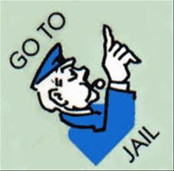
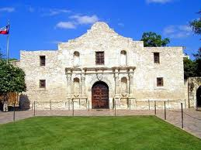
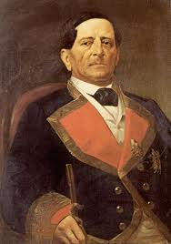
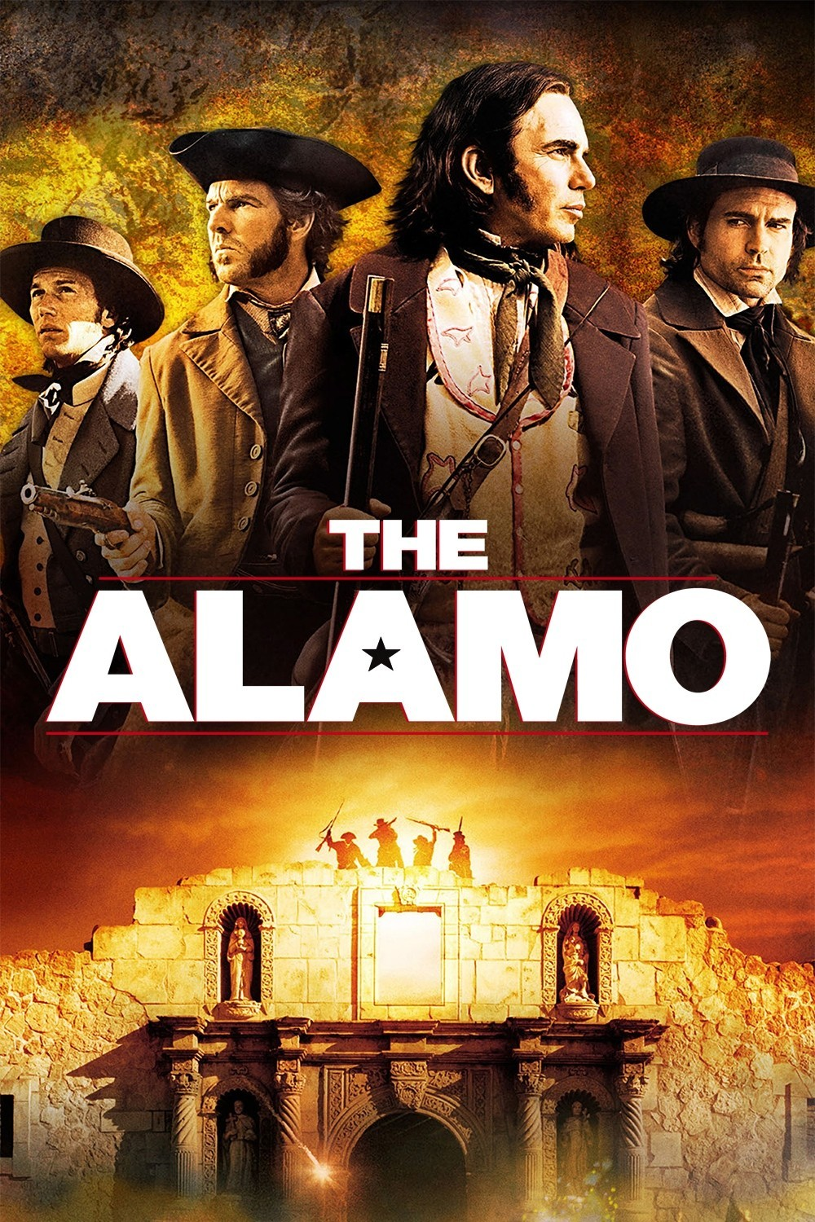
The Lone Star Rebellion
Texas declares independence in 1836
Sam Houston named “commander in chief”
Santa Anna (leader of Mexico) sends 6,000 troops into Texas
Alamo: 13 day siege, all Americans are killed
San Jacinto:
Sam Houston captures Santa Anna, sings 2 treaties
Withdraws Mexican troops, recognizes boundary of Texas
Texas wants to join Union!
Fear from North because issue of slavery
Jackson recognizes Republic of Texas on last day of office
Who holds the balance of power in Congress now?

Slide 16
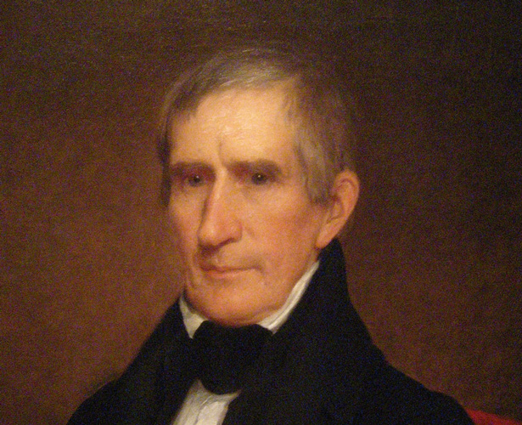
Log Cabins and Hard Cider of 1840
William Henry Harrison vs. MVB in election
WHH adopts log cabin and hard cider as campaign platform
Plays into Democratic hands of “common man”
Significance of election:
First mass-turnout election in American history
Propaganda and silly slogans set unfortunate example for future campaigns.

